Slide 1
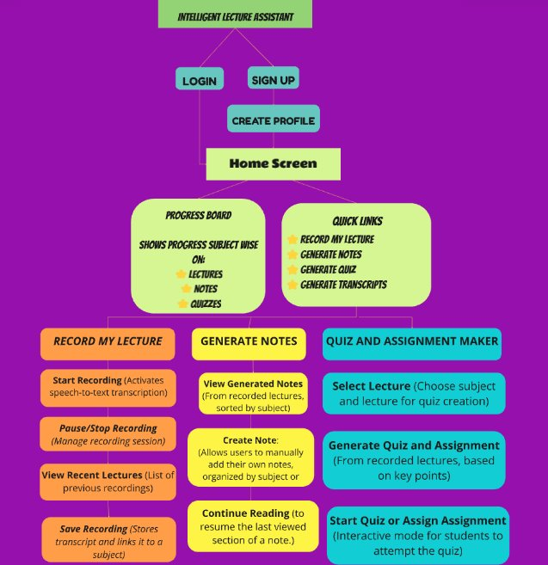
Task Flow Of The App

Slide 2
LOW FI PROTOTYPE
Our project focuses on creating a user-friendly app tailored to the diverse needs of three primary user groups: students, teachers, and independent educators. For students, it enhances learning with real-time transcription, summaries, and quiz creation. Teachers benefit from the streamlined creation of notes, assignments, and classroom resources. Independent educators gain tools to produce professional-quality content efficiently. This approach ensures broad accessibility, supporting various teaching and learning styles while fostering productivity and engagement.

Slide 3
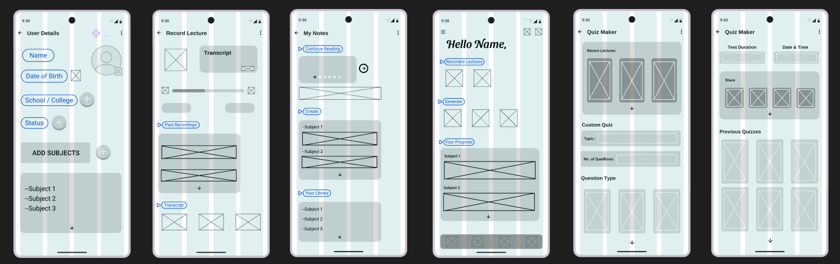
Lo-Fi Design I

Slide 4
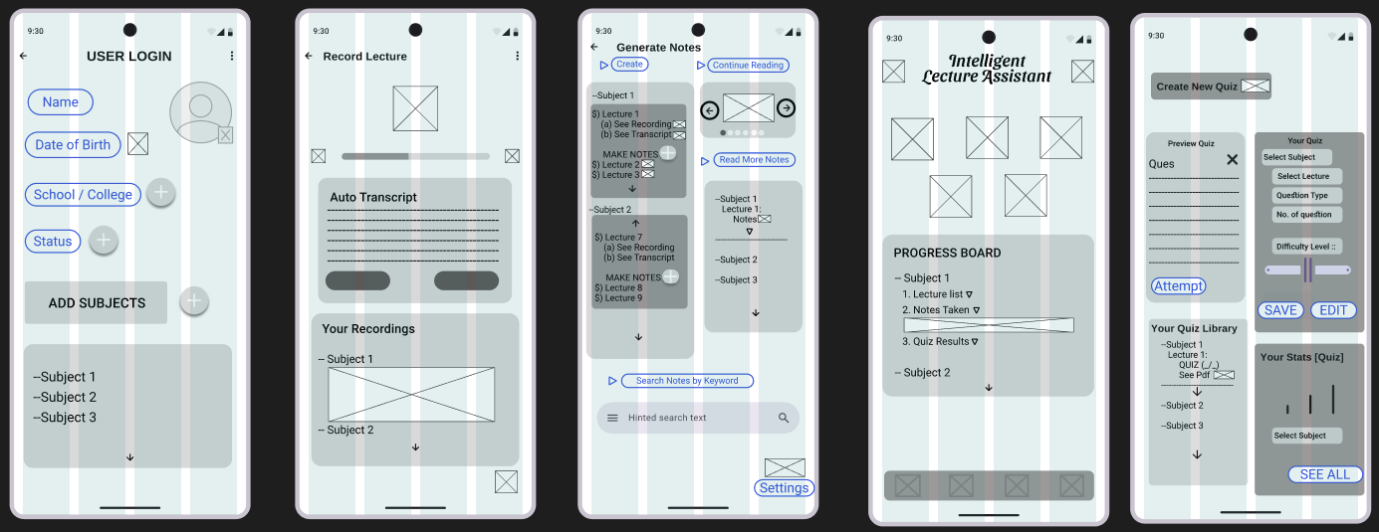
Lo-Fi Design II

Slide 5
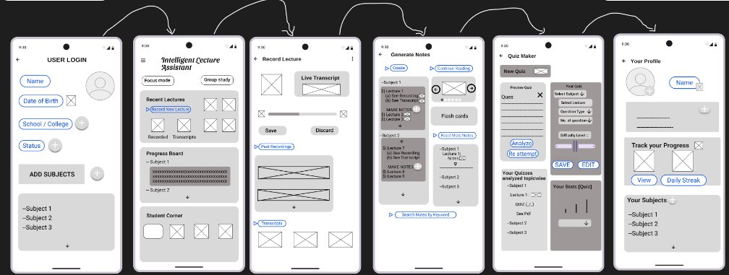
FINAL LOW FI DESIGN

Slide 6
Explanation Of The Wireframe
The app opens to a Welcome Screen, offering options to Sign Up for new users or Login for existing users.
After logging in, the user is directed to the Homepage, which acts as a
central hub for accessing key features.
On the Homepage, students can view a list of their saved lectures or start a Live Lecture Session, enabling real-time transcription and summary creation.
Teachers and independent educators can navigate to the Content Creation Page, where they can upload lecture recordings or notes to generate quizzes, assignments, and transcripts automatically.
The Notes and Summaries Section allows users to review, search, and organize generated lecture notes.
A Quiz and Assignment Section lets users manage quizzes and assignments created from lecture content.
A Profile Page provides options to view usage statistics, manage preferences, and access personalized recommendations.

Slide 7
HI- FI PROTOTYPE
A high-fidelity prototype is a polished and interactive representation of the Intelligent Lecture Assistant app, closely resembling the final product. It begins with a visually engaging Welcome Screen for signing up or logging in, leading to a dynamic Homepage where users can access lectures, start live sessions, or create content. Features like real-time transcription with highlighted key points, organized notes and summaries, customizable quizzes, and assignments are seamlessly integrated. The design includes a Profile Page for analytics and recommendations.

Slide 8
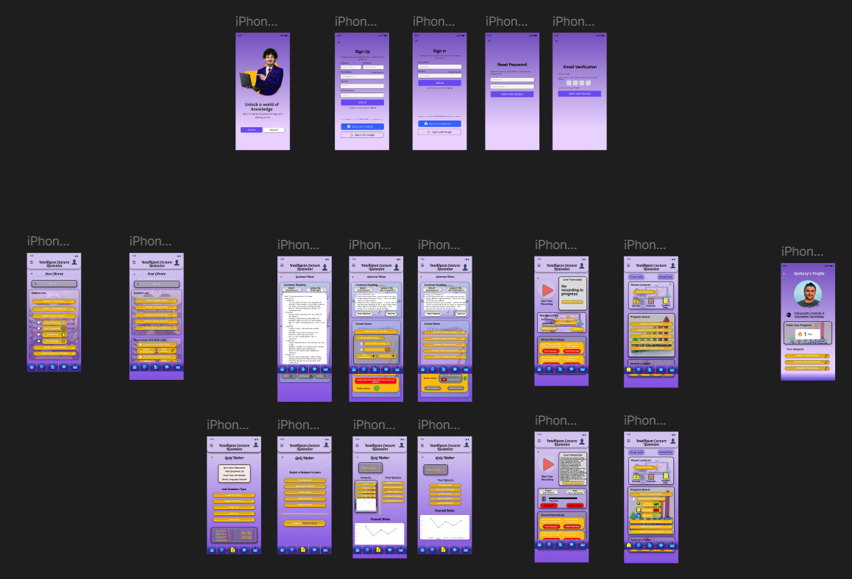
HI- FI PROTOTYPE
Hi Fi link

Slide 9

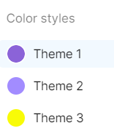
HI- FI PROTOTYPE
LOGO
The logo for our Intelligent Lecture Assistant embodies the core purpose of the app: to streamline learning and teaching processes through technology. The design reflects a blend of education and innovation,
Colour Styles
The purple background symbolizes creativity and knowledge, reflecting the app's educational focus. The yellow buttons stand out, representing clarity and focus, making key actions easy to identify and encouraging user interaction.
Hi Fi link

Slide 10

HI- FI PROTOTYPE
Hi Fi link

Slide 11
Thank You

